Slide 1

Portable Antivirus System
Prepared by-
1.Akshay S. Chavan
2.Ashutosh Bhawsar
3.Jayesh Suryavanshi

Slide 2

Contents
Problem Statement
Introduction
Working of Antivirus System
Detection Techniques
Signature Based Detection
Heuristic Analysis
Algorithm- MD5 Algorithm
Working of each model
Advantages and Disadvantages
Future Enhancement.
References.

Slide 3
Problem Statement
Currently all the antiviruses available in market are specific for a single computer system.
We can not use that installed antivirus to other computer system, that means they all are system specific.
We all have to pay a lot of cost for such a antivirus system, and when it expires we have to renew it time by time.
To overcome such a problem we have made an antivirus system which is portable

Slide 4

Introduction
Any external drive as well as system drive can be infected by various malicious programs. This malicious programs may enter into your external drive and Once your external drive has been infected, all the data on it might get corrupted or deleted.
This utility will scan system drives as well as usb drive and uninfect it from various malicious program.

Slide 5
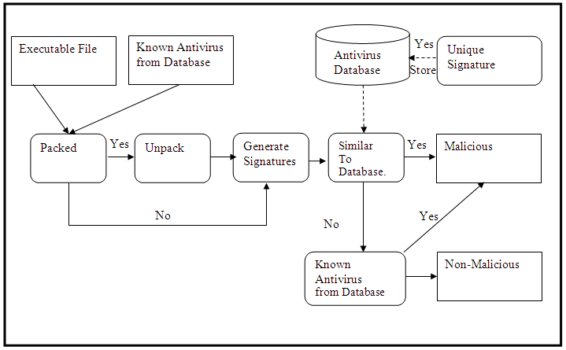
Working of Anti-virus System

Slide 6
Detection Techniques:
Signature based detection technique :
It is a traditional, simple and efficient method.
Scans file and generates hash values.(signatures)
On the basis of this signature it detects various viruses.
If signature is not available in database, then virus cannot be detected, so it is unreliable.

Slide 7
Diagrammatic review of Signature based detection technique
Signature Based Detection Cont…

Slide 8
B. Heuristic scanning
To overcome the problem of signature based detection, Heuristic scanning is introduced.
Heuristic analysis is used to detect new unknown viruses.(DELETE C)
It checks for particular commands related with malicious programs.
Scans boot record ,executable files, Macro files(System files).

Slide 9
MD5 Algorithm
Steps:
Padding
Append Length
Divide input into 512 bit blocks
Initialize Chaining Variables
Final Process Blocks

Slide 10
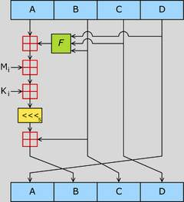
MD5 Algorithm-Final Rounds/Steps

Slide 11
Working of each modules
Hide\Unhide Data:-
Used to unhide data which is made hidden by a virus
Also to hide the data of selected path
Deletes autorun.inf(if available) from selected directory
Creates .bat file and starts the process after execution completes,file deleted itself.
Remove lnk Viruses:-
Find .lnk file in selected directory
List of .lnk files will be shown
User can delete a single file or delete all files

Slide 12
Working Module Cont…
Reports:-
Detected files will be listed.
User can delete single file or delete all.
Logs:-
Entry of each scan made in the logs.
It is separate for each computer system
Definition Update:-
Virus definition can be updated using offline method by selecting the folder containing “VirusDef.txt” file. Only “VirusDef.txt” file is accepted other files are rejected.
Backup of previous definition is taken.

Slide 13
Exclusion:- Any extension or file can be added to exclusion Excluded extension or file will not be scanned, the file will be skipped Automatic Delete:- Used to delete infected file automatically This can be enabled or disabled Load Virus Hash:- Loads all the virus hashes from the Virus Definition All other functions starts when loading virus hash work is completed
Working Module Cont…

Slide 14
Advantages:-
No prerequisites:-
The prerequisite is already installed in windows
Low Memory:-
It take less space 50mb in USB Drive.
Enhance Scanning:-
It will scan usb drive as well as System drives also.
Saves system space:-
Saves Memory of computer system to installed Antivirus software.
Less chances to conflict:-
Less chances to conflict the utility with system antivirus.

Slide 15
Disadvantages:-
Takes More time:-
It takes little more time to analysing the content of usb drive to scan.
Delete Files:-
It does not repair the files. It directly deleted instead of repairing.
Update offline
The virus database should be updated without internet connection
Protection cannot be stopped
The protection system cannot be stopped or paused for sometime

Slide 16
Future Enhancement:-
At present the utility has to be started manually.we will try to make it to start automatically when usb devices plugged in.
Currently the viruses found are directly deleted,in future enhancement instead deletion we will try to repair the file.
Currently our database is updated offine. In future,we will try to update our database online.
We will try to scan all the computers connected in a network

Slide 17
Conclusion
Our utility is portable antivirus by keeping it in external drive and that's why it become portable and not become specific for any particular system.
Also we added some extra features which are not included in other antivirus software

Slide 18
References
Peter Zsor, The art of computer virus research and defense, Addison-Wesley, Maryland, USA, 2005.
Michael Erbschloe., Trojams, Worms, and Spyware, Butterworth-Heinemann publications. Oxford, UK, 2005
John Aycock, Computer Virus and Malware, Springer Science+Business Media, LLC. Calgary,Canada, 2006.
Cameron H. Malin, Eoghan Casey, James M. Aquilina, Malware Forensics: Investigating and Analyzing Malicious Code, Spi Publishing Services, Burlington, USA, 2008.
Mark A Ludwig, The Giant Black Book of Computer Viruses, American Eagle Publication, Arizona, USA, 1995.

Slide 19
Web References
http://www.anti-virus-softwarereview.com/
http://www.antivirus-software.com/
http://www.buzzle.com/articles/different-types-of-computerviruses.html
http://www.spamlaws.com/ virus-types.html
http://www.ehow.com/list-7258284computer-virus-detectiontechniques.html

Slide 20
Thank You!

